Slide 1
Your GIMP Portfolio
Navigation Menu

Slide 2
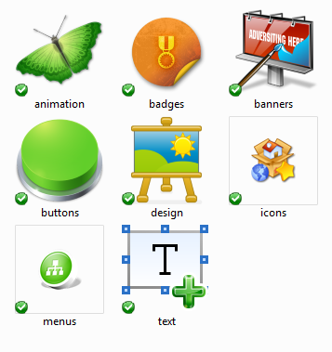
Create a navigation menu for your portfolio site. The following is an EXAMPLE, you do not have to create this, but you do have to make one for your portfolio site.
I decided I wanted to use the Horizontal Nav Menu (from the menus page).
I went to http://www.veryicon.com/icons/internet--web/icons-web-20/ and typed in text, badges, etc. and found icons for each page I’m going to create. I download the 16x16 windows .ico versions.
Create your gimp portfolio site folder on the server (if you haven’t already) create an index.html page and add the <html>, <head>, <title>, </title>, </head>, <body>, </body>, and </html>tags. Go ahead and add the <header> and <nav> sections to it as well.
In the Nav section create your navigation links.
Be sure to add an images folder to the server and add all of your icon images to it.
I added my gimp portfolio banner to the images folder as well and a link to display the banner on the index.html page.

Slide 3
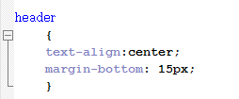
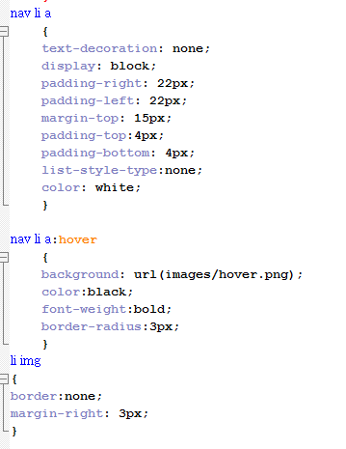
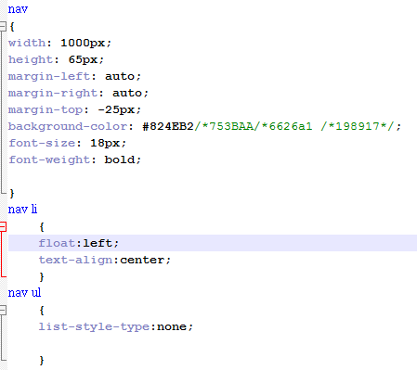
Create a css style page and upload it to the server. Make sure you link to the style page from your index page
Make adjustments from the original CSS design as needed.
I played around with several nav background colors and I pulled the original color from one of the spheres then went to www.color-hex.com/ to find a lighter shade.
I created and added a hover button, then gave it a border radius using CSS
Remember this is YOUR portfolio site. Be creative change colors, change style, make it your own. ☺

Slide 4
Regular Nav
Regular Nav with Hover button
Banner image with Nav and hover effect

